Slide 1

Database Systems
CS 372
LAB 3

Slide 2
Lab objective
Naming & Dropping the constraint
DML(Data Manipulating Language)
INSERT
UPDATE
DELETE

Slide 3

Naming & Dropping Constraints

Slide 4
Naming a constraint
Naming a constraint allows you to drop the constraint easily.
1)when a table is created
CREATE TABLE table_name (
column_name Datatype ,…..,
CONSTRAINT Constraint_name Constaint _Type column_name )

Slide 5

Naming a constraint
EX:

Slide 6
Naming a constraint (Cont.)
2) After the table is created
ALTER TABLE table_name ADD CONSTRAINT Constraint_name Constraint _type column_name

Slide 7
Naming a constraint (Cont.)
EX:

Slide 8

Dropping a constraint

Slide 9

DML
2

Slide 10
DDL &DML
1. Data definition language (DDL) | CREATE ALTER DROP TRUNCAT RENAME
2. Data manipulation language (DML) | INSERT UPDATE DELETE MERGE

Slide 11
INSERT

Slide 12
1- Insert
Add a new rows to a table by using the INSERT statement.
You Can Insert a row by using Two Ways:
1. Specify the columns name
INSERT INTO table_name (column1 ,….,column n)
VALUES (value1,…., value n)
INSERT INTO DEPARTEMENT (Dname,Dnumber ,Mgr_ssn, Mgr_start_date)
VALUES('Research',5,'333445555','1988-05-22')

Slide 13
1- Insert
2. Or without columns name
INSERT INTO table_name
VALUES (value1, value2, value3,...)
INSERT INTO DEPARTEMENT
VALUES('Administration',4,'987654321','1995-01-01')

Slide 14
Inserting Rows with Null Values
Explicit method: specify the NULL keyword.
We can use this method with both ways of insert statement (Specify the columns name and without columns name)
INSERT INTO DEPARTEMENT (Dname,Dnumber , Mgr_ssn, Mgr_start_date)
VALUES('Research',5,'333445555',NULL)

Slide 15
Inserting Rows with Null Values
Implicit method: omit the column from the column list We can use this method with only (Specify the columns name)
INSERT INTO DEPARTEMENT (Dname, Dnumber,Mgr_ssn)
VALUES('Research',5,'333445555')

Slide 16
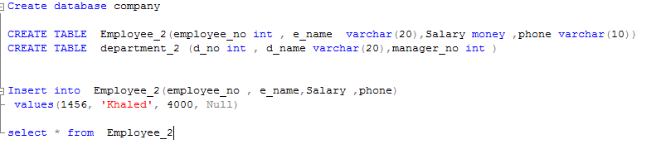

Examples of Inserting Rows with Null Values
Explicit method: (Specify the columns Name)

Slide 17
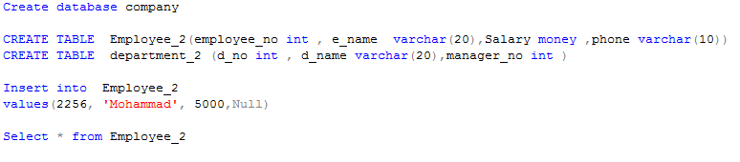
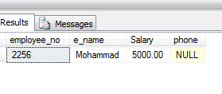
Examples of Inserting Rows with Null Values
Explicit method: (without columns name)

Slide 18

Examples of Inserting Rows with Null Values
Implicit method: with only (Specify the columns name)
Ex: If I don’t add the phone No: Just delete the Attribute name from Attribute list and of course, there is no phone value in Values list.

Slide 19
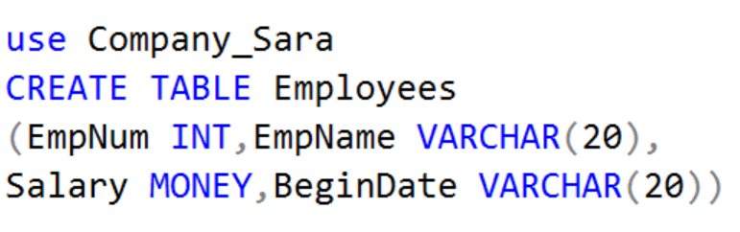
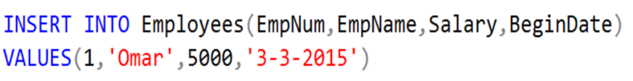


Examples of Inserting Rows
Using this Database
1
Values compatible with columns in number and Datatype
All Columns

Slide 20
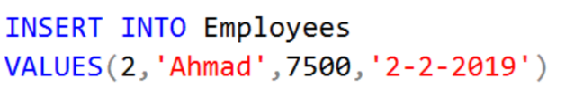
Examples of Inserting Rows
1
Values compatible with columns in number and Datatype
All Columns
2
Without columns name
All values of fields must be given

Slide 21

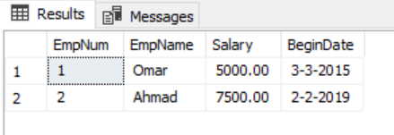
Examples of Inserting Rows
To display all records

Slide 22
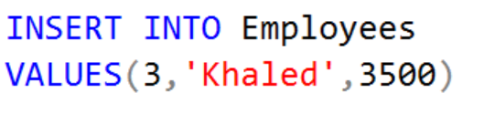


Examples of Inserting Rows
3
Insert Into
(Without columns name
If u omit a value from Values list, you will get an Error

Slide 23
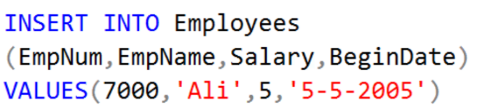

Examples of Inserting Rows
4
Change the orders of the entered values
If the data types are compatible the record will be inserted into table But this will cause a logic error

Slide 24

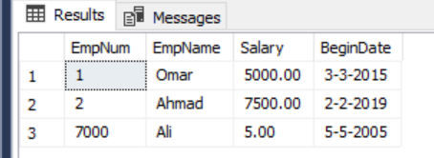
Examples of Inserting Rows
4
Logic error

Slide 25
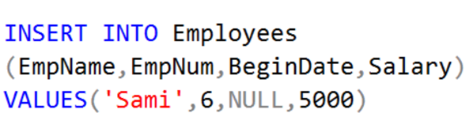



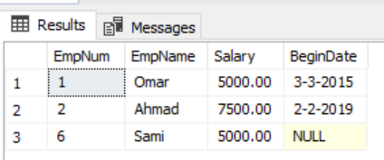
Examples of Inserting Rows
5

Slide 26
Declaring variables in SQL
Declare @variable_name Datatype =value
EX:
Declare @myVar VARCHAR(10) = 'Yoohoo'
OR
Declare @variable_name Datatype
SET @variable_name=value
EX:
Declare @myVar VARCHAR(10)
SET @myVar = 'Yoohoo'

Slide 27
Inserting values by Using Variables
DECLARE @DP_NUMBER INT
SET @DP_NUMBER=5
INSERT INTO DEPARTEMENT (Dname, Dnumber, Mgr_ssn, Mgr_start_date)
VALUES('Research',@DP_NUMBER,'333445555',NULL)

Slide 28
UPDATE

Slide 29
2-UPDATE
The SQL UPDATE Query is used to modify the existing records in a table.
You can use WHERE clause with UPDATE query to update selected rows otherwise all the rows would be effected.
When use WHERE clause (specific rows will affect) :
UPDATE table_name
SET column_name=value
WHERE condition

Slide 30
2-UPDATE
UPDATE employee
set Salary = Salary * 1.1
where Ssn ='333445555’
UPDATE employee
set Salary = Salary * 1.1
Note: You can combine N number of conditions using AND or OR operators.

Slide 31
DELETE

Slide 32
3-DELETE
The SQL DELETE Query is used to delete the existing records from a table.
You can use WHERE clause with DELETE query to delete selected rows, otherwise all the records would be deleted.
When use WHERE clause (specific rows will delete) :
DELETE FROM table_name
WHERE condition

Slide 33
3-DELETE
DELETE FROM DEPARTEMENT
Where Dnumber=1
Without WHERE (all the rows will delete ):
DELETE FROM DEPARTEMENT

Slide 34
Exercise
Create a database (company_lab3)
Create two tables in the database:
Employee
(e_name , employee_no , Salary, e_gender)
Department
( d_No , d_name , manager)
In Employee table:
Salary should be > 1500
employee_no should be unique
Default value for the gender is female

Slide 35
Exercise
In Department table:
d_No doesn't accept null value
Fill each table with 3 records
4.Drop the constraint of default value in Employee table
Delete the male employee in Employee table

Slide 36



Any Questions?..

